Slide 1

Gym-mate

Slide 2

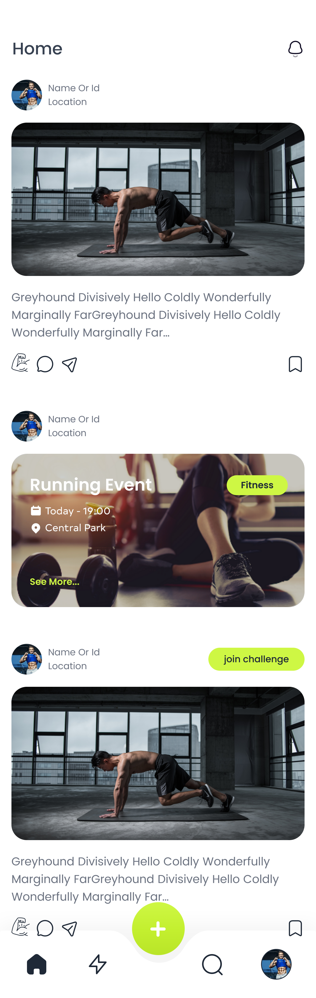
Gym-mate
Introducing the Gym-Mate. Gym-Mate is a social application based on sport and workouts. What Gym-Mate is built for is to focus on sharing workout moments and help people to be more motivated and support each others to do more healthy life style. Even people can make money in app and have their own professional accounts like coach or trainer account, where they connect to others.

Slide 3
Gym-mate has three main parts
Social
Recording workouts
Workout sessions
(trainers profile)
In social section users can share their workouts and challenge others to do workouts and challenges or invite them to events, or people who needs to find a mates for their workout they can find online gym-mates or in person gym-mates. They can find about coaches and gyms and do workouts with groups.
In social section users can share their workouts and challenge others to do workouts and challenges or invite them to events, or people who needs to find a mates for their workout they can find online gym-mates or in person gym-mates. Also after workout they can monitor the states of their workout like how much calorie they have burned or how much intensive their session was and etc.
They can find about coaches and gyms and do workouts with groups.
Trainers have some cool features in their profile that now a days most of theme suffering from lack of platforms for they needs like organized scheduling and connect It to their list of classes, need of a platform to perform online and scheduled classes or a calendar to book a class

Slide 4
Social
Social is about sharing feeds and challenges or even joining events. Social is the main page of the application and contains three type of data.
one of the is feeds which is about sharing what workout user has done and it can gain power based on its popularity. (card one)
Challenge card is also similar to feeds but users can challenge each others to do some workouts like 10 pull ups or other type of activity that challenge them to do it. (card three)
Events card contains the information of the events like what the events is for and the time, price and location of each events. (card two)

Slide 5
Feed
ABOUT: Feeds are for sharing picture, video and sport stats (like the duration, calorie, intensity and etc.) of the users to motivate and invite each others to do sport or show their skills to people who needs professional helps and they can gain popularity by their Feeds.
USER DESCRIPTION: To post a feed:
step one: user first should hit the plus button which in the middle of navigation bottom.
Step two: the gallery and camera will show up for user to select the pictures or video and the stats of their workout.
Step three: user click next button the they have fill the inputs location – description – category of the sport like fitness, running, etc. (All the filed except picture or vide are optional)
Step four: they will hit the post button and Done!
And then user will automatically be redirected to main page to see its feed.
Also users can edit or delete their feeds. (for edit only description or location are available)
EXCUTIVE: Feed contains picture, power button, bookmark, comments, share button, feed owner, location, is feed (by default).

Slide 6
CHALLENGE
ABOUT: Challenges are the same as Feeds. By default there are feeds which there is an option for user when posting the feed the check it as challenge. After posting the challenge there will be and option (a button to join challenge) for others to join the challenge and do the workout and they will be added to the list of the challenge.
Challenges have types like chain challenge or based owner challenge, etc.
USER DESCRIPTION: To post a Challenges:
step one: user first should hit the plus button which in the middle of navigation bottom.
Step two: the gallery and camera will show up for user to select the pictures or video and the stats of their workout.
Step three: user click next button the they have fill the inputs location – description – category of the sport like fitness, running, etc. (All the filed except picture or vide are optional)
They have to toggle the button type from feed to challenge otherwise it will be posted as feed.
Step four: they will hit the post button and Done!
And then user will automatically be redirected to main page to see its feed.
Also users can edit or delete their feeds. (for edit only description or location are available)
EXCUTIVE: Feed contains picture, power button, bookmark, comments, share button, feed owner, location, is challenge.

Slide 7
EVENT
ABOUT: Events are for meetings and events like running or other type of activities base on location or type of sport, they can be online or in person,
USER DESCRIPTION: Events can only be created by professionals or trainers or gyms. Users can join events with out limitation when a user clicked to join and event they will be directed to its single page which there is more information about it. After paying the price for event it will be shown in user’s profile. (some events can be free)
For creating an Event there is an option in plus button, then by selecting it a from will be shown to user and they have to fill the inputs of: cover – title – start time – end time – start date – end date – description – price (also can be free). Some inputs are optional like end time – end date.

Slide 8
EVENT
EXCUTIVE: cover – schedule (start/end) – time (start/end) – location – type(online – in person ) – price – workout type – title – user – limitation (cam be unlimited)

Slide 9
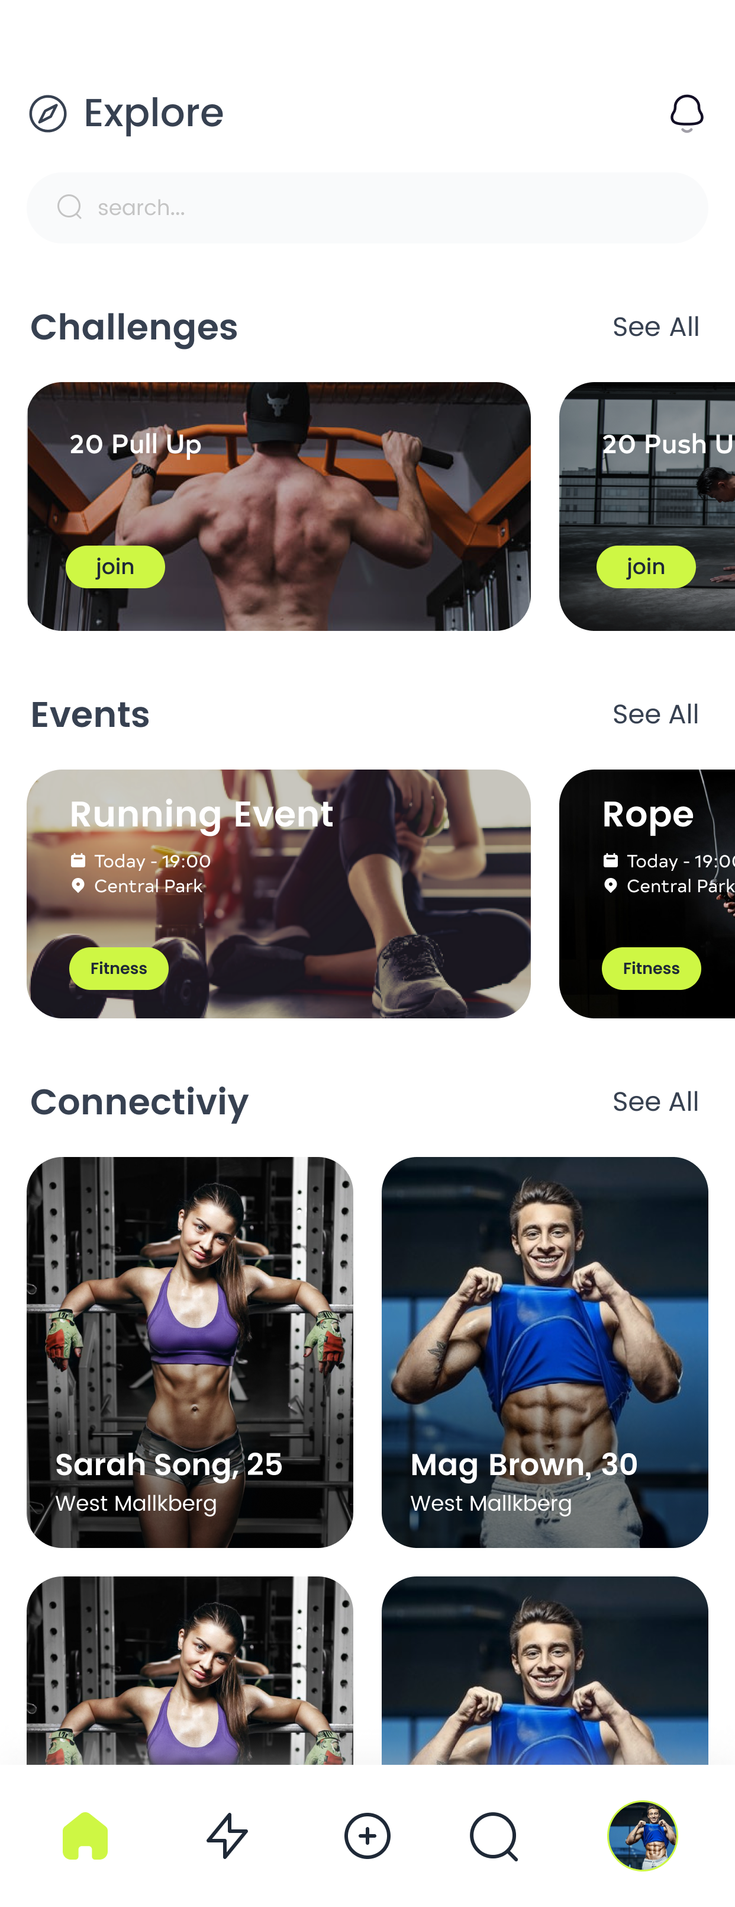
EXPLORE
ABOUT: Explore has made of three main slider which are Challenge list, Event list, Connectivity list. In each of these sections the most poplars or recent , or by location will be shown.
USER DESCRIPTION: users can find best challenges events or coaches, they can hit the see all (popular accounts on gym-mate)

Slide 10
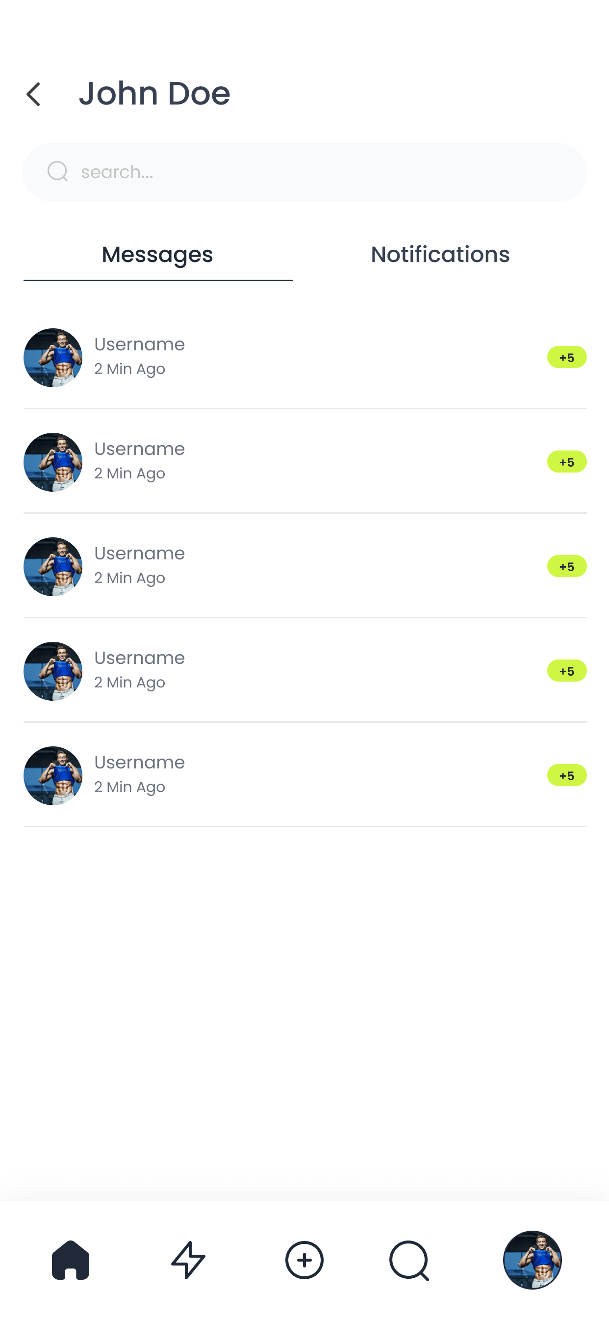
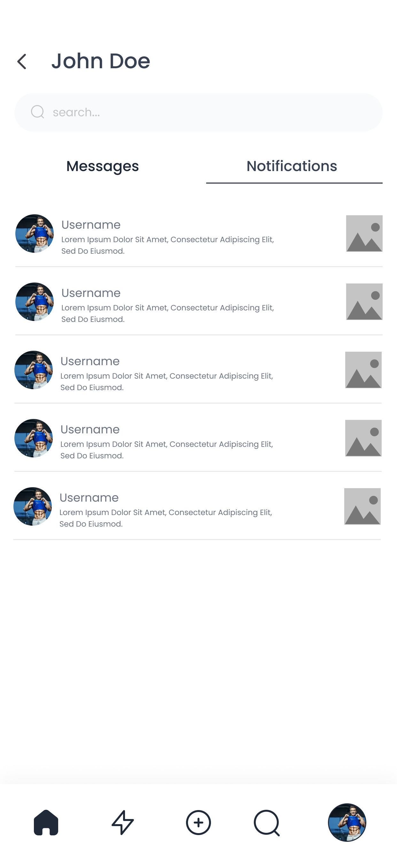
Notifications and messages
ABOUT: Bell notification has two primary tabs which are Messages and notifications. Notifications contains every activity and interactions of users together.
Messages are like Instagram chat which users can interact and chat together. In chat users can send each others text messages and pictures.
USER DESCRIPTION: notifications are being given based on powers, comments, subscribers,
Users can turn on notifications for other users if they post a feed challenge or event(optional).
EXCUTIVE Notification: user avatar – username – description – pic of the feed, etc.
EXCUTIVE messages: user avatar – time message – count messages

Slide 11
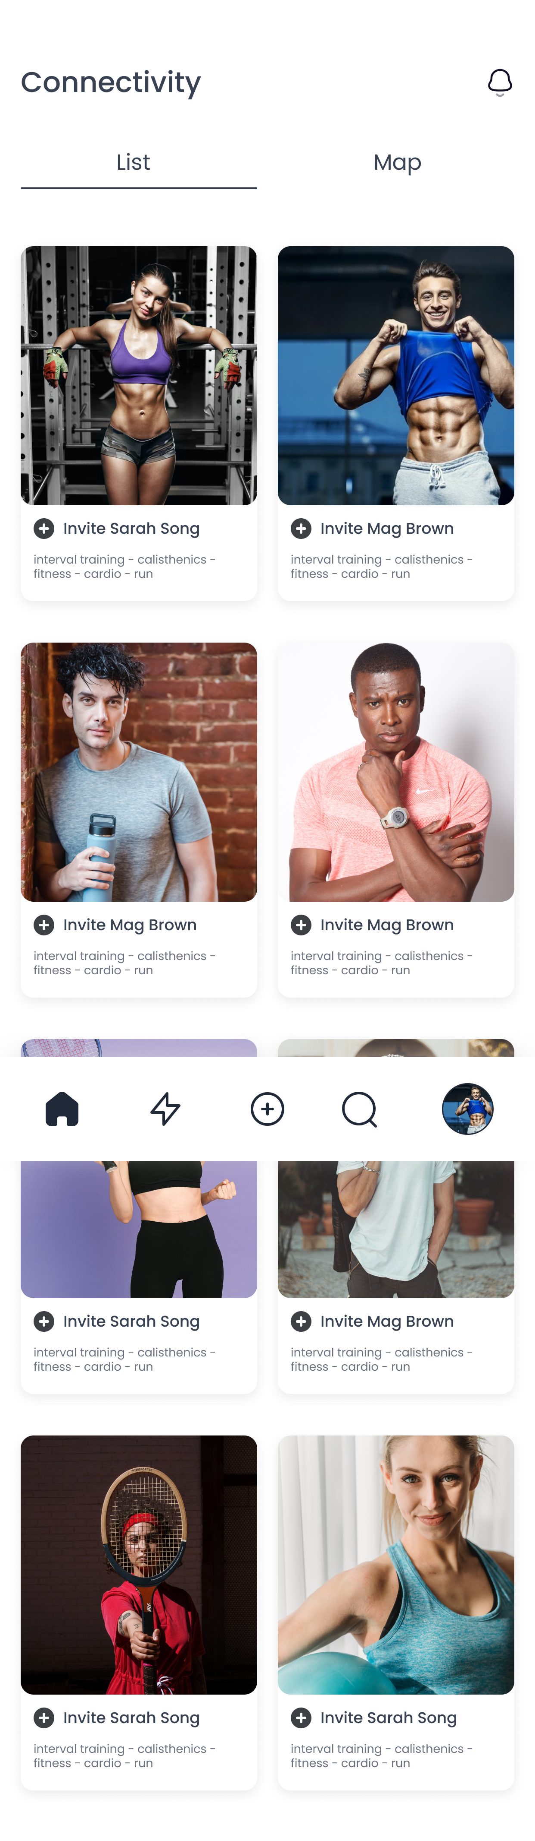
CONNECTIVITY
ABOUT: connectivity cards are suggestions of the popular or related users to others to discover more people and expand their community. People can find each others based on their interest, location, or random.
USER DESCRIPTION: user can hit the plus button to follow each others or click on cards to be directed to individuals profile.
EXCUTIVE: picture – button plus – name – interests

Slide 12
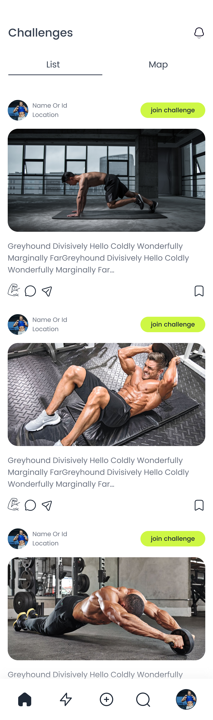
CHALLENGE LIST
ABOUT: contains all the challenges base on popularity, title, or interests of the users also they can search what they want to see in search box
EVENT LIST
ABOUT: contains all the events base on popularity, title, or interests of the users also they can search what they want to see in search box

